Slide 1

KYC

Slide 2

What is KYC?
KYC stands for Know Y our Customer
The Bank checks the identity of its customers through KYC
CUSTOMER
So that nobody else does anything in your name
CUSTOMER
SOMEBODY ELSE

Slide 3

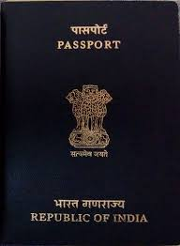
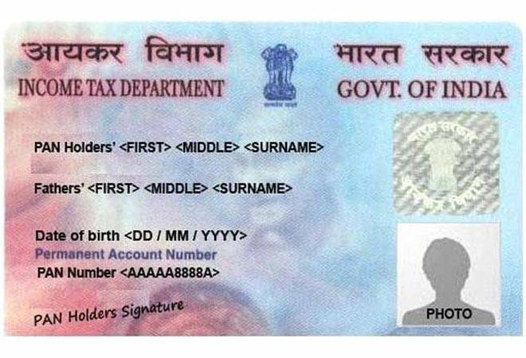
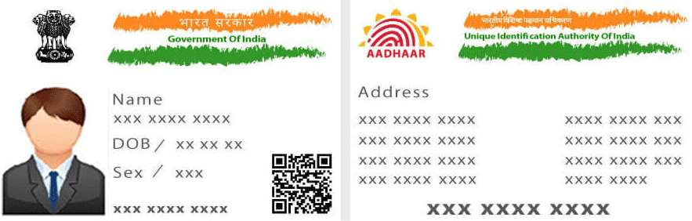
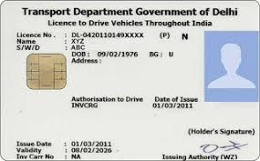
What are mandatory KYC documents?
Proof of Identity
You are who you say you are
Proof of Address
You live where you say you live
Passport
Driver’s License
Aadhar Card
PAN Card

Slide 4
Where can I get KYC done?
At Banks
At service centres where KYC forms are available
You can download the form online
You have to carry original documents for verification and submit photocopies

Slide 5
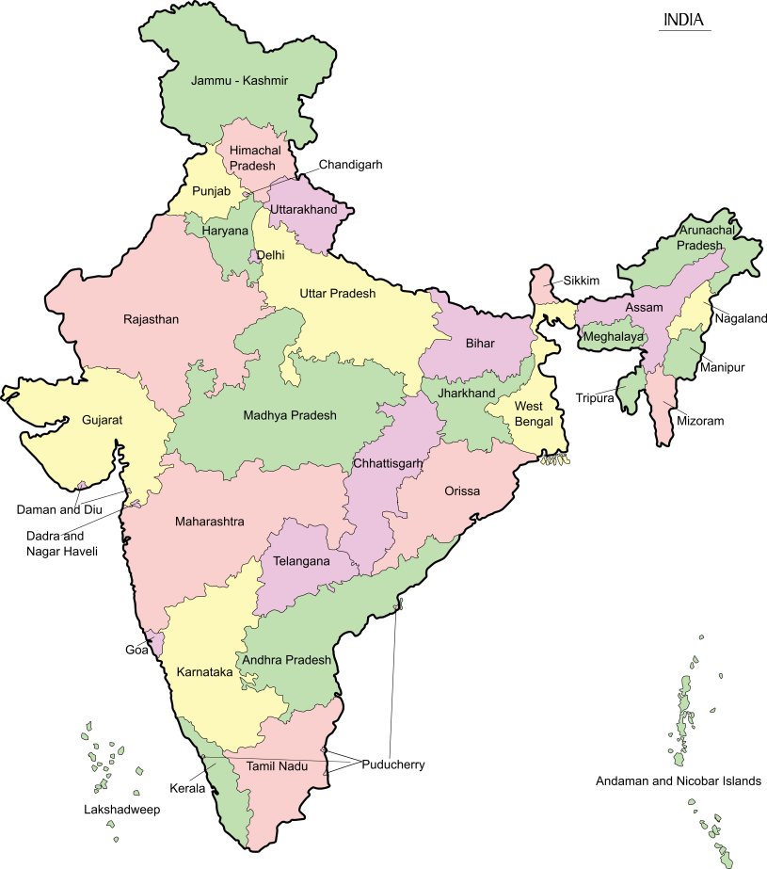




What is Aadhar card?
5485 5000 8000
5485 5000 8000
It is a UNIQUE number issued to every Indian citizen
A person’s personal details are stored in a Government Database
That can be accessed from anywhere in India
Gender
Name
Address
DOB
Government
Database

Slide 6




Who is eligible for an Aadhar card?
Can I apply for an Aadhar card for my 3 year old daughter.
I just turned 15 years old. I heard I can apply for an Aadhar card. Is it true?
You can apply for an Aadhar card for her but details will have to be updated when she turns 5 and again when she turns 15
All people living in India above the age of 15 years can apply for an Aadhar Card

Slide 7
How can I apply for an Aadhar card?
Collect the documents you need
Proof of Identity
Proof of Relationship to the head of the house
Book an appointment with enrolment centre by visiting the UIDAI website
If you have an Aadhar card, you can download an e-Aadhar online by submitting your Aadhar number

Slide 8
If you don’t already have an Aadhar card, apply for one immediately as it is now mandatory to have an Aadhar card even to open a bank account!

